Slide 1
Design and evaluation of an adaptive lane keeping system

Slide 2
Background
In recent years, the total of traffic accidents has been increasing due to the increasing number of cars.
Unintended lane departures account for a high percentage of road accidents in general and especially severe accidents.
The lane keeping system (LKS) can actively control the vehicle steering to help the driver keep the car within the lane to reduce the risk of lane departure effetely.

Slide 3
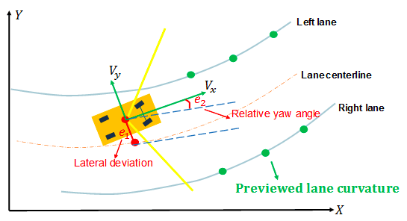
Lane Keeping System
Bicycle model in terms of lateral deviation and relative yaw angle with
respect to the center line of the lane

Slide 4
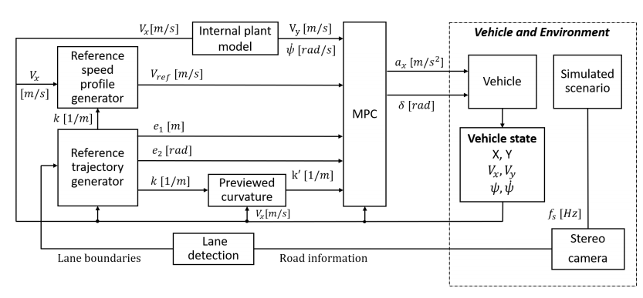
model predictive control structure

Slide 5
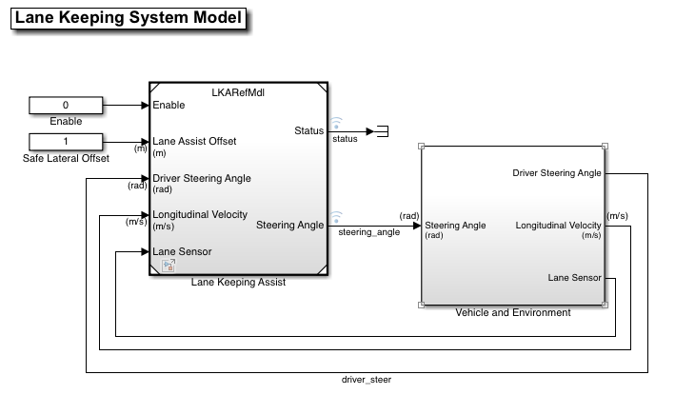
System Model

Slide 6
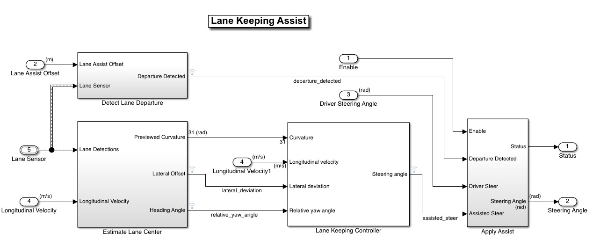
Lane Keeping Assist Model

Slide 7
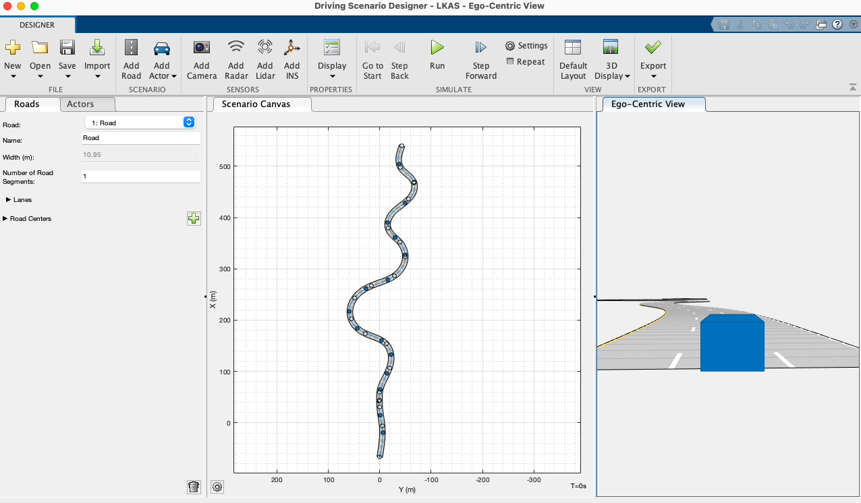
environment and vehicle

Slide 8
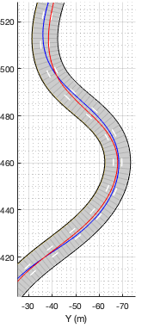
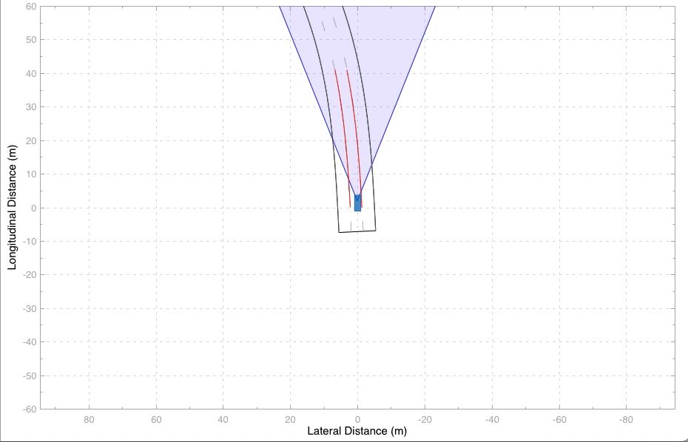
Simulations Results and Discussion

Slide 9
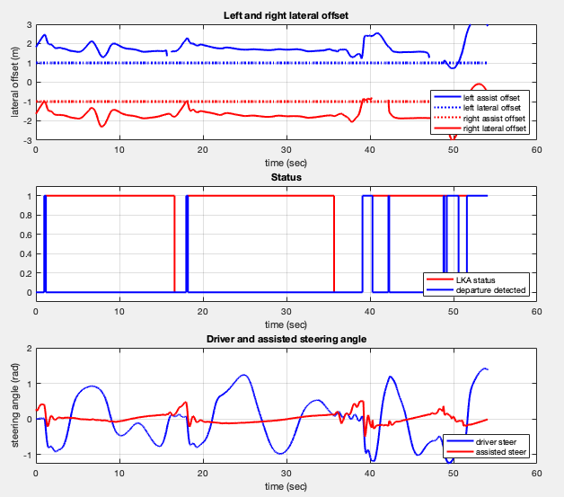
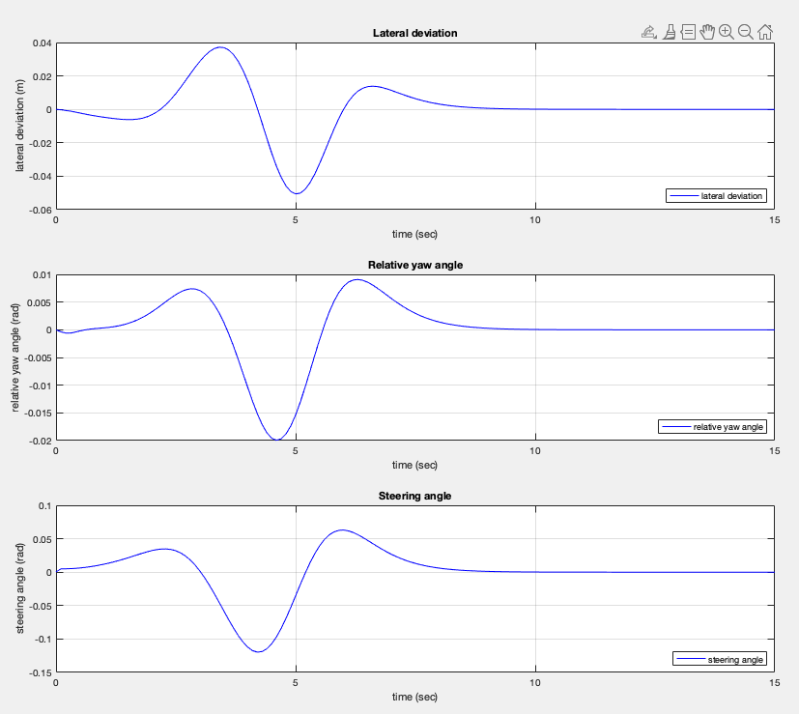
Simulations Results and Discussion

Slide 10
conclusion
This project has successfully developed and simulated the Lane Keeping System (LKS) using the Model Predictive Control, , and this system has been validated through software simulation on the SIMULINK environment.
In the next few years, the developed lane keeping system will be sufficiently capable of being used worldwide by the improvement of the reliability and stability of the system.

Slide 11
ThaNK YOu

